Slide 1
DATA MINING Introductory and Advanced Topics Part II
Margaret H. Dunham
Department of Computer Science and Engineering
Southern Methodist University
Companion slides for the text by Dr. M.H.Dunham, Data Mining, Introductory and Advanced Topics, Prentice Hall, 2002.

Slide 2
Classification Outline
Goal: Provide an overview of the classification problem and introduce some of the basic algorithms
Classification Problem Overview
Classification Techniques
Regression
Distance
Decision Trees
Rules
Neural Networks

Slide 3
Classification Problem
Given a database D={t₁,t₂,…,t_{n}} and a set of classes C={C₁,…,C_{m}}, the Classification Problem is to define a mapping f:DgC where each t_{i} is assigned to one class.
Actually divides D into equivalence classes.
Prediction is similar, but may be viewed as having infinite number of classes.

Slide 4
Classification Examples
Teachers classify students’ grades as A, B, C, D, or F.
Identify mushrooms as poisonous or edible.
Predict when a river will flood.
Identify individuals with credit risks.
Speech recognition
Pattern recognition

Slide 5
Classification Ex: Grading
x
If x >= 90 then grade =A.
If 80<=x<90 then grade =B.
If 70<=x<80 then grade =C.
If 60<=x<70 then grade =D.
If x<50 then grade =F.
<90
>=90
x
A
<80
>=80
x
B
<70
>=70
x
C
<50
>=60
F
D

Slide 6
Classification Ex: Letter Recognition
View letters as constructed from 5 components:
Letter A
Letter B
Letter C
Letter D
Letter E
Letter F

Slide 7
Classification Techniques
Approach:
Create specific model by evaluating training data (or using domain experts’ knowledge).
Apply model developed to new data.
Classes must be predefined
Most common techniques use DTs, NNs, or are based on distances or statistical methods.

Slide 8
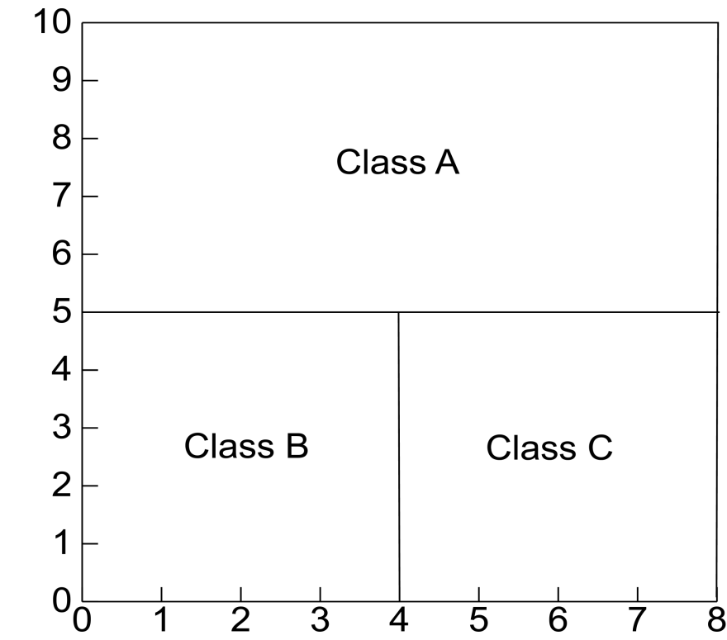
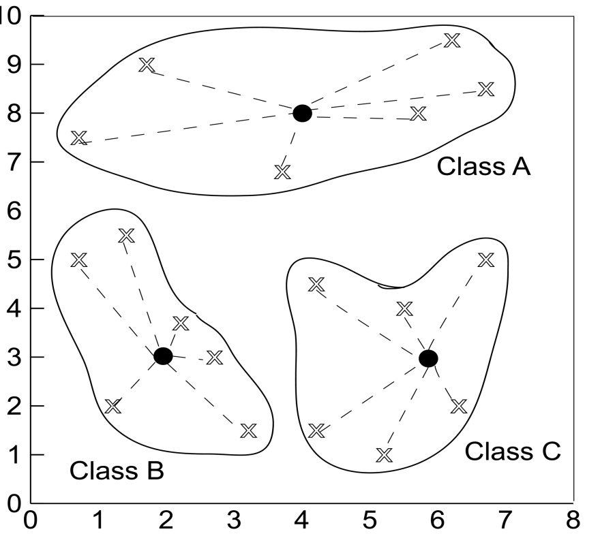
Defining Classes
Distance Based
Partitioning Based

Slide 9
Issues in Classification
Missing Data
Ignore
Replace with assumed value
Measuring Performance
Classification accuracy on test data
Confusion matrix
OC Curve

Slide 10
Height Example Data

Slide 11
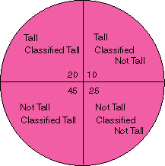
Classification Performance
True Positive
False Negative
False Positive
True Negative

Slide 12
Confusion Matrix Example
Using height data example with Output1 correct and Output2 actual assignment

Slide 13
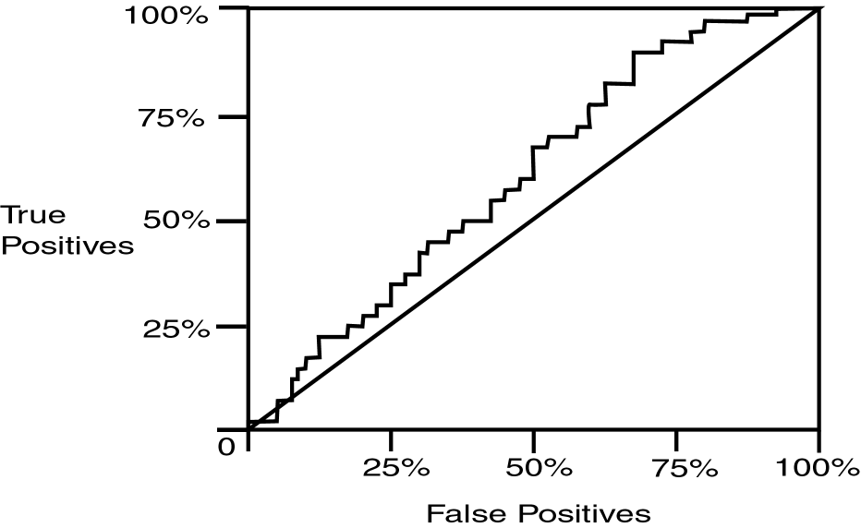
Operating Characteristic Curve

Slide 14
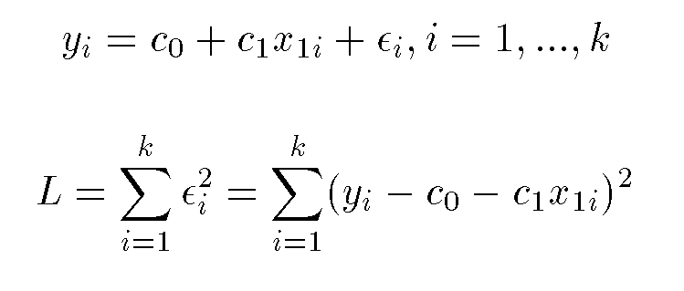
Regression
Assume data fits a predefined function
Determine best values for regression coefficients c₀,c₁,…,c_{n}.
Assume an error: y = c₀+c₁x₁+…+c_{n}x_{n}+ε
Estimate error using mean squared error for training set:

Slide 15
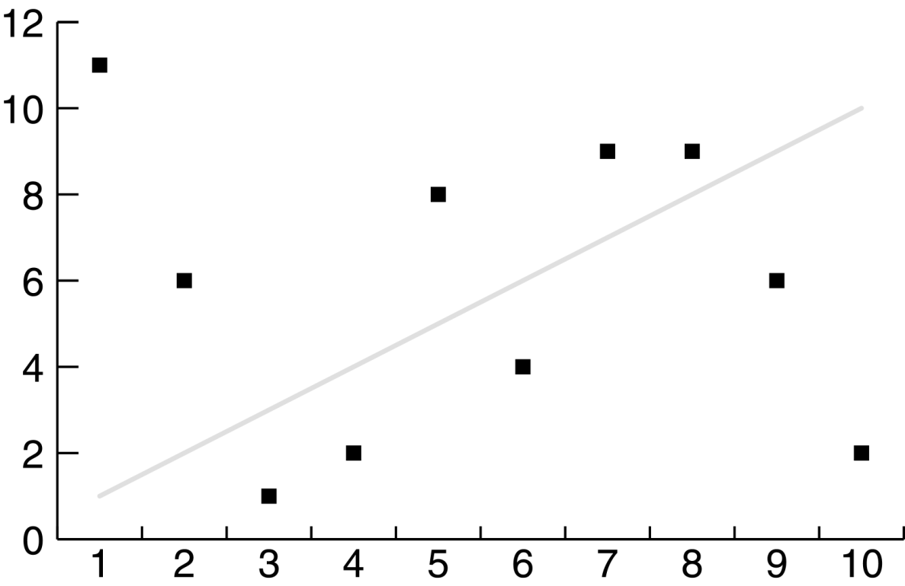
Linear Regression Poor Fit

Slide 16
Classification Using Regression
Division: Use regression function to divide area into regions.
Prediction: Use regression function to predict a class membership function. Input includes desired class.

Slide 17
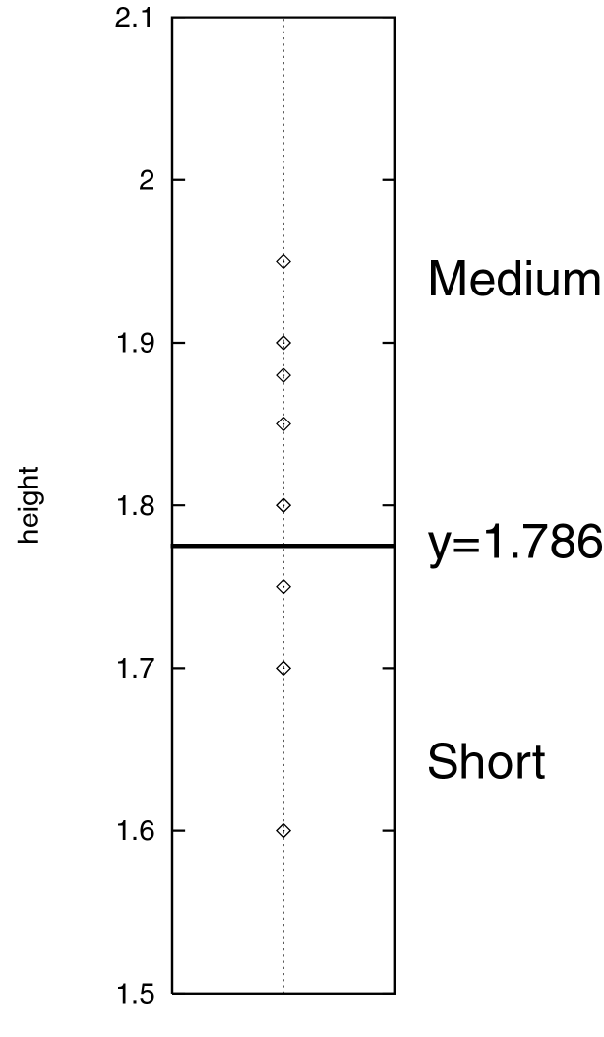
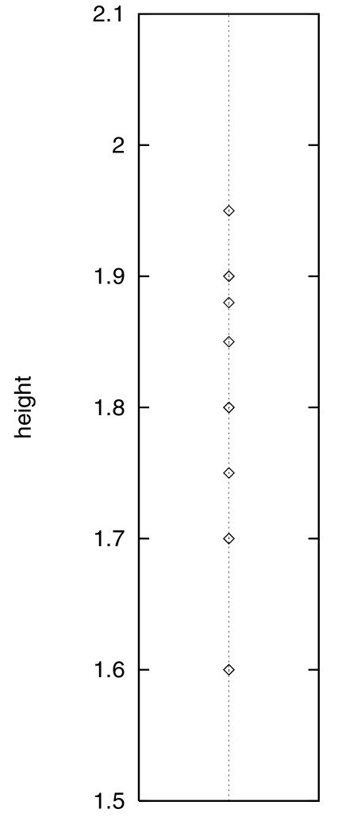
Division

Slide 18
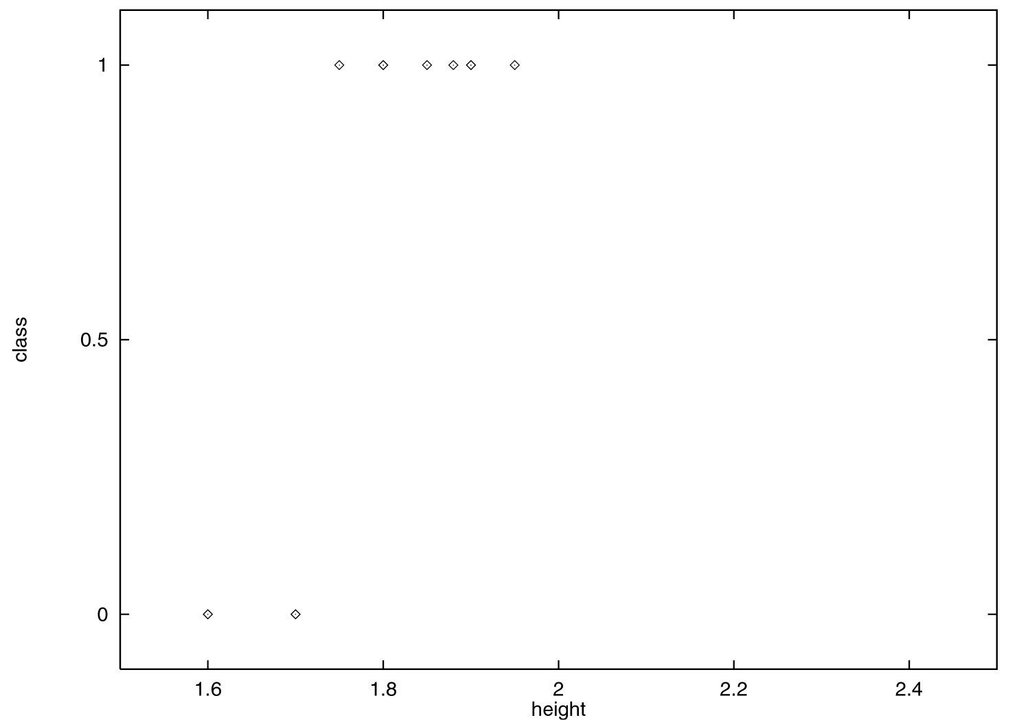
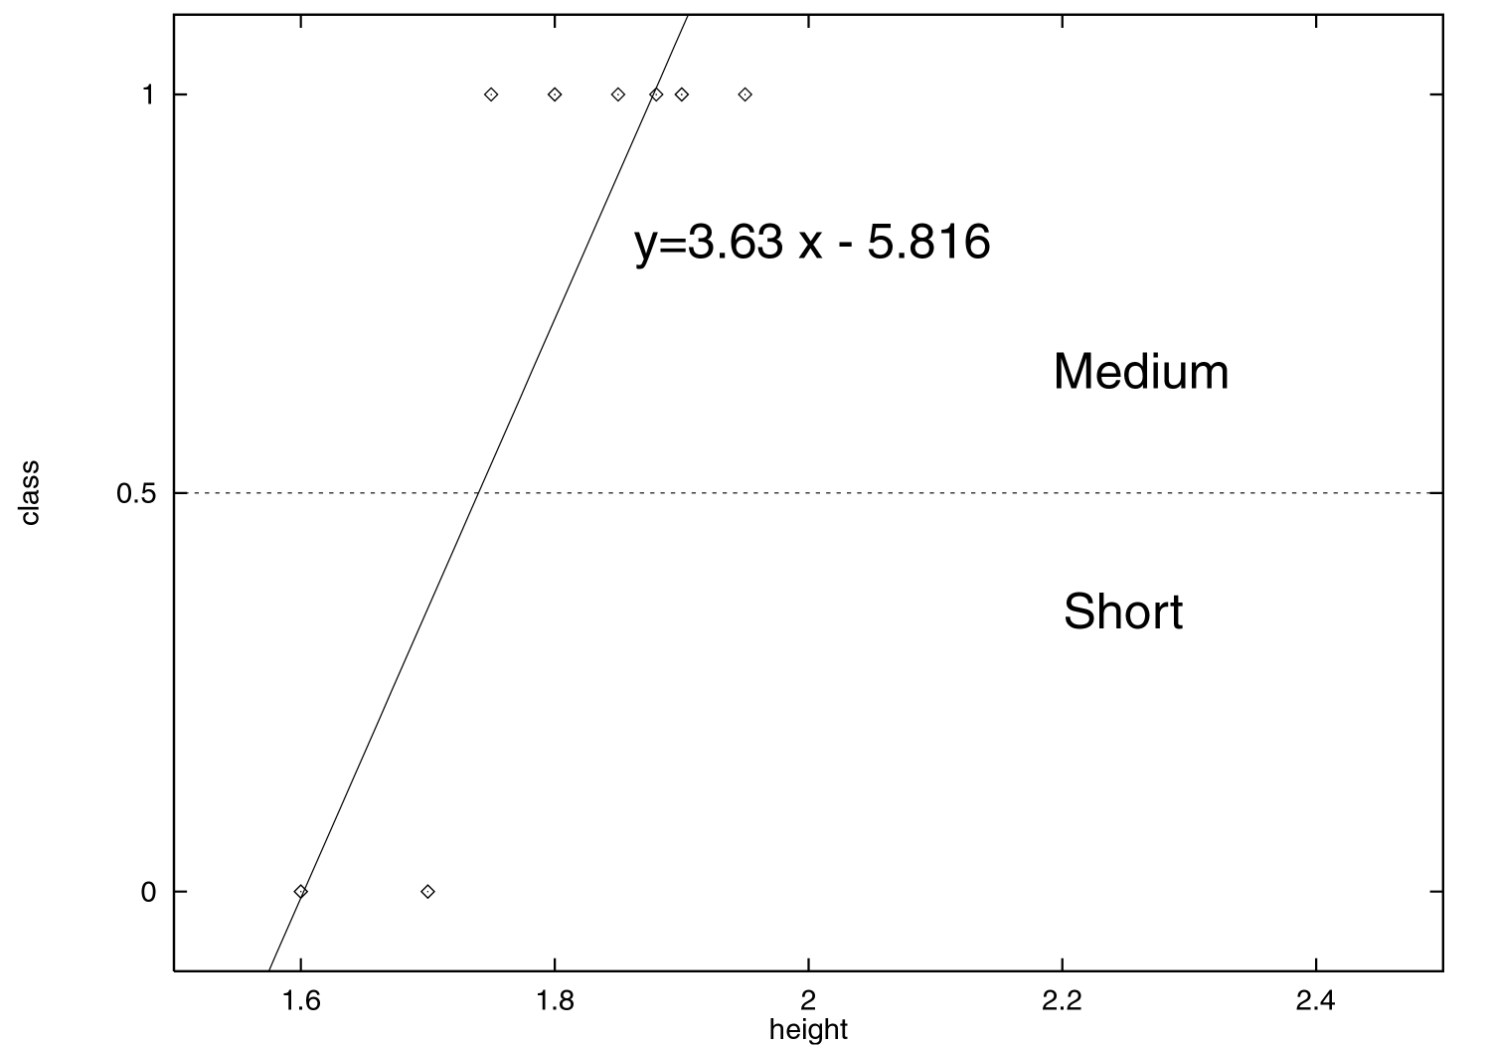
Prediction

Slide 19
Classification Using Decision Trees
Partitioning based: Divide search space into rectangular regions.
Tuple placed into class based on the region within which it falls.
DT approaches differ in how the tree is built: DT Induction
Internal nodes associated with attribute and arcs with values for that attribute.
Algorithms: ID3, C4.5, CART

Slide 20
Decision Tree
Given:
D = {t₁, …, t_{n}} where t_{i}=<t_{i1}, …, t_{ih}>
Database schema contains {A₁, A₂, …, A_{h}}
Classes C={C₁, …., C_{m}}
Decision or Classification Tree is a tree associated with D such that
Each internal node is labeled with attribute, A_{i}
Each arc is labeled with predicate which can be applied to attribute at parent
Each leaf node is labeled with a class, C_{j}

Slide 21
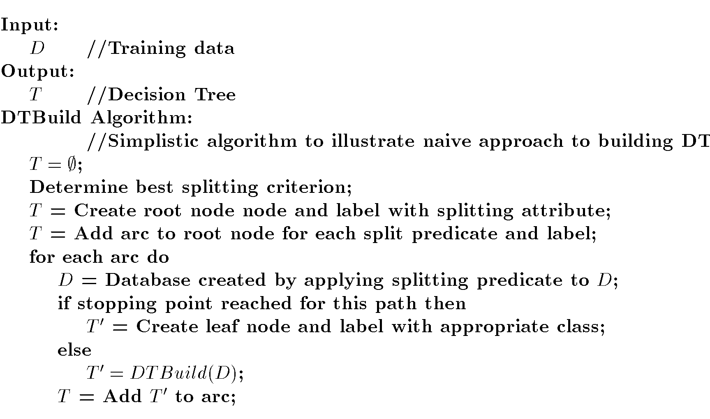
DT Induction

Slide 22
DT Splits Area
M
Gender
F
Height

Slide 23
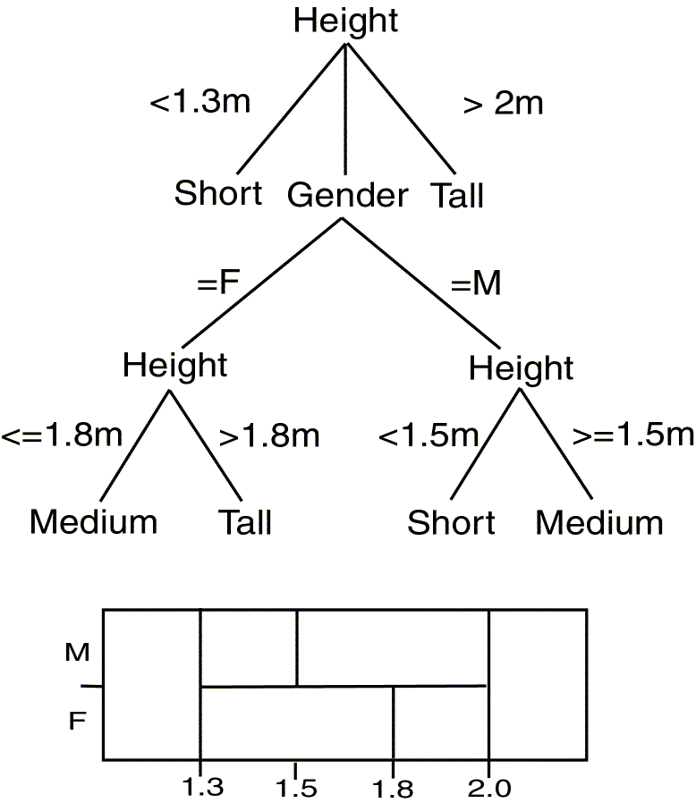
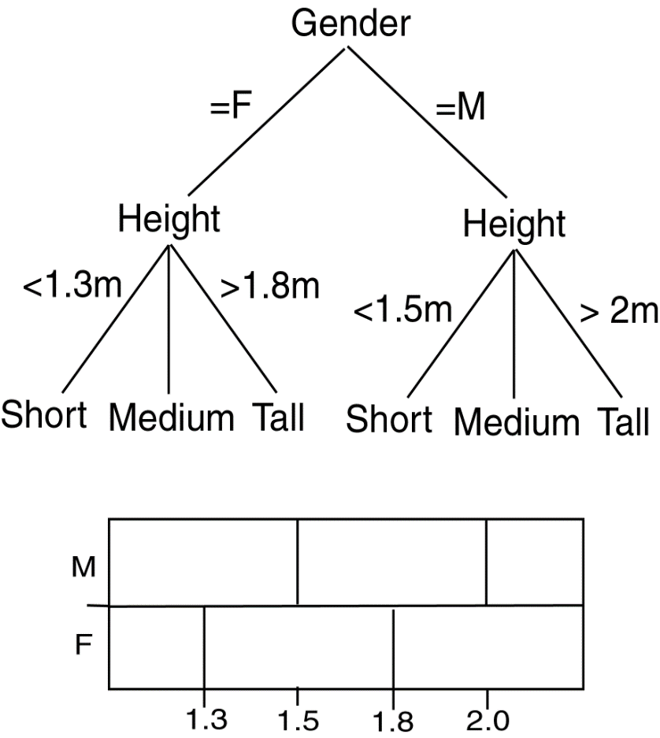
Comparing DTs
Balanced
Deep

Slide 24
DT Issues
Choosing Splitting Attributes
Ordering of Splitting Attributes
Splits
Tree Structure
Stopping Criteria
Training Data
Pruning

Slide 25
Decision Tree Induction is often based on Information Theory So

Slide 26
Information

Slide 27
DT Induction
When all the marbles in the bowl are mixed up, little information is given.
When the marbles in the bowl are all from one class and those in the other two classes are on either side, more information is given.
Use this approach with DT Induction !

Slide 28
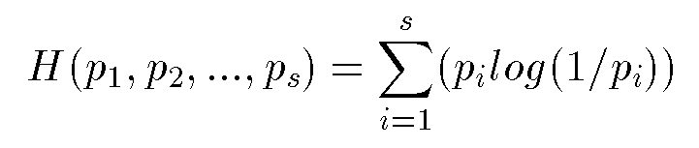
Information/Entropy
Given probabilitites p₁, p₂, .., p_{s} whose sum is 1, Entropy is defined as:
Entropy measures the amount of randomness or surprise or uncertainty.
Goal in classification
no surprise
entropy = 0

Slide 29
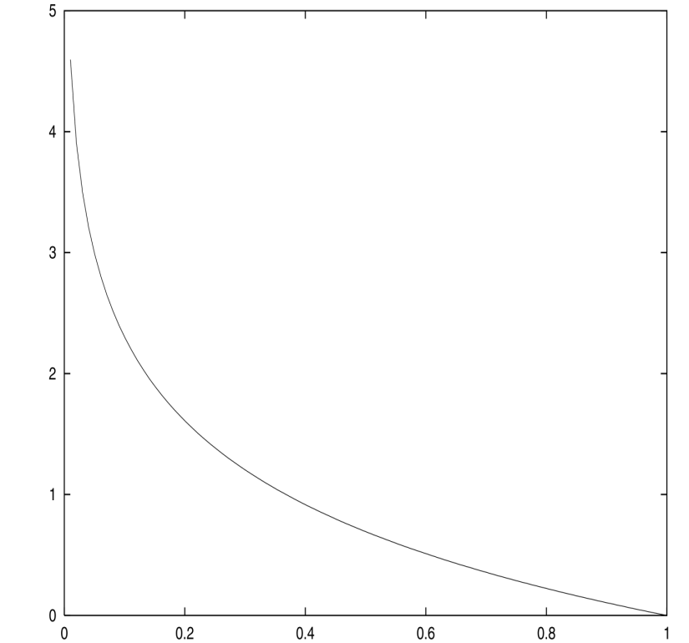
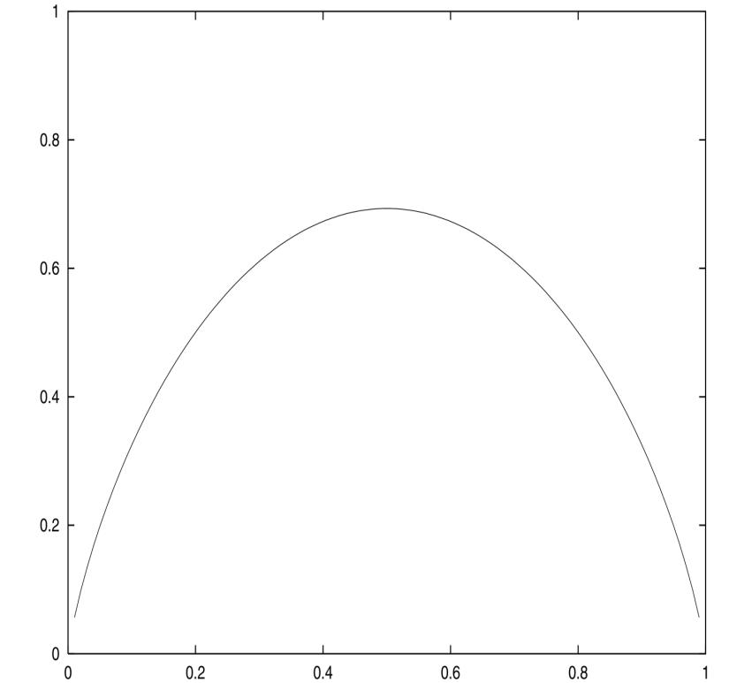
Entropy
log (1/p)
H(p,1-p)

Slide 30
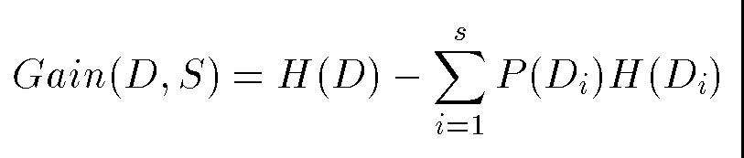
ID3
Creates tree using information theory concepts and tries to reduce expected number of comparison..
ID3 chooses split attribute with the highest information gain:

Slide 31
Height Example Data

Slide 32
ID3 Example (Output1)
Starting state entropy:
4/15 log(15/4) + 8/15 log(15/8) + 3/15 log(15/3) = 0.4384
Gain using gender:
Female: 3/9 log(9/3)+6/9 log(9/6)=0.2764
Male: 1/6 (log 6/1) + 2/6 log(6/2) + 3/6 log(6/3) = 0.4392
Weighted sum: (9/15)(0.2764) + (6/15)(0.4392) = 0.34152
Gain: 0.4384 – 0.34152 = 0.09688

Slide 33
Looking at the height attribute,
(0. 1.6] : 2
(1.6, 1.7] : 2
(1.7, 1.8] : 3
(1.8, 1.9] : 4
(1.9, 2.0] : 2
(2.0, ∞ ) : 2

Slide 34
Looking at the height attribute,
(0. 1.6] : 2 2/2(0) + 0 + 0 = 0
(1.6, 1.7] : 2 (2/2(0) + 0 + 0) = 0
(1.7, 1.8] : 3 (0 + 3/3(0) + 0) = 0
(1.8, 1.9] : 4 (0 + 4/4(0) + 0) = 0
(1.9, 2.0] : 2 (0 + ½(0.301) + ½ (0.301) = 0.301
(2.0, ∞ ) : 2 (0 + 0 + 2/2(0)) = 0

Slide 35
The gain in entropy by using the height attribute is thus
0.4384 – 2/15 (0.301) = 0.3983

Slide 36
